Slide 1


Quizzes
ASEN 3728 Aircraft Dynamics
UNIVERSITY OF COLORADO BOULDER

Slide 2
True or False Question
Expect TRUE/FALSE questions as part of the Homework and Exams. In all cases students are expected to provide a concise, correct, logically sound justification for full credit.

Slide 3
TF 1
True or False: Given this velocity vector one can conclude that the aircraft is ascending? Justify your answer.
a) True
b) False

Slide 4

TF 1
True or False: Given this velocity vector one can conclude that the aircraft is ascending? Justify your answer.
The vector is the inertial velocity expressed in body coordinates. In order to know if the aircraft is ascending you need to know the vector in inertial coordinates. In order to calculate this vector, we need to know the orientation of the aircraft.
False
Both figures satisfy the given conditions!

Slide 5
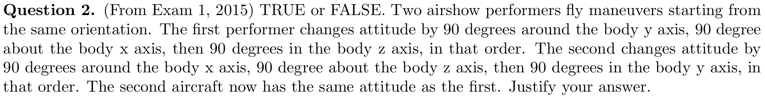
TF 2
A: True
B: False

Slide 6
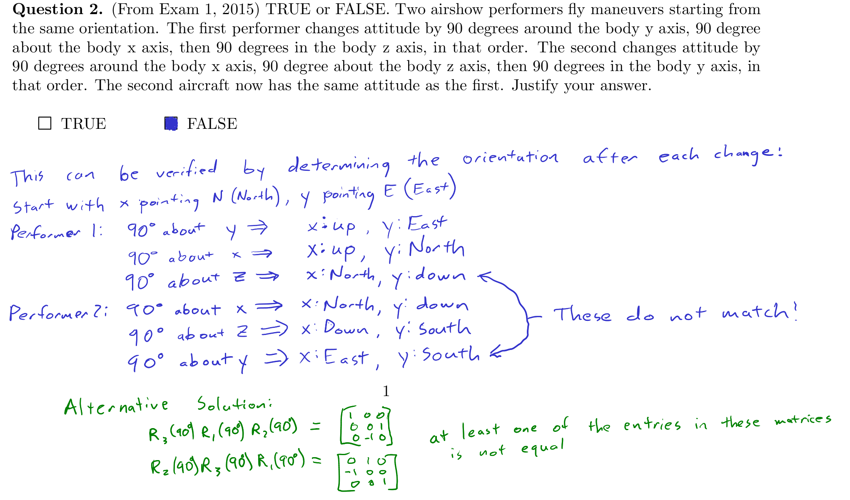
TF 2

Slide 7
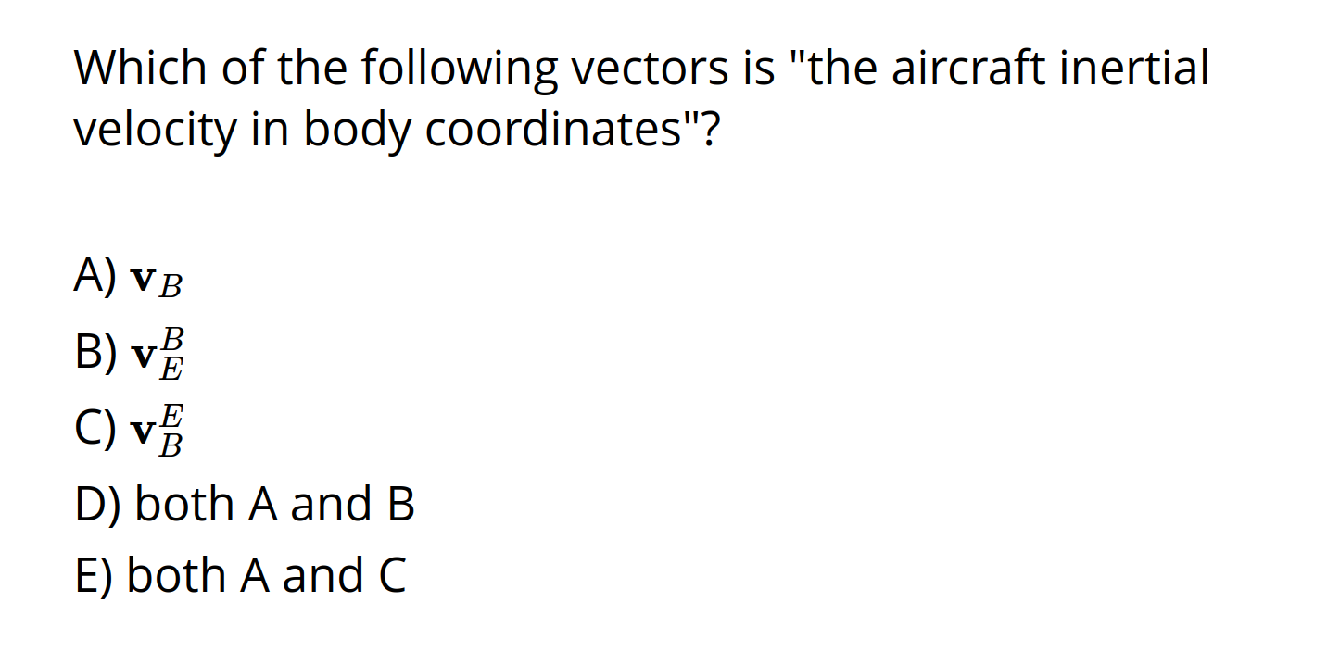
MC 1
Correct Answer: B

Slide 8
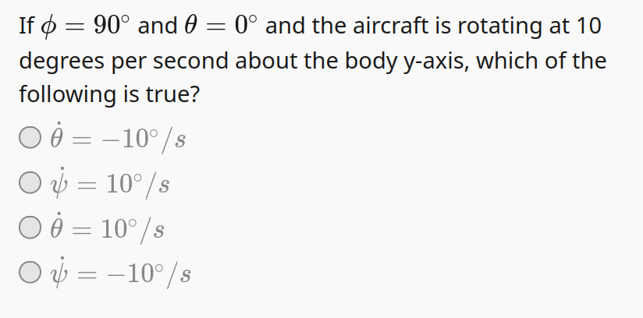
MC 2
Correct Answer: B

Slide 9
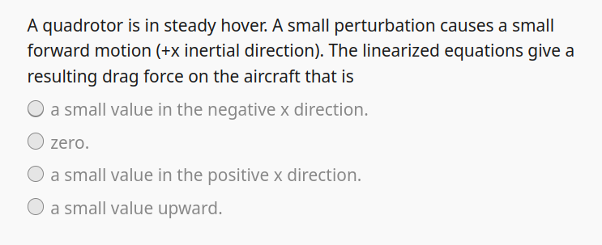
MC3
Correct Answer: B

Slide 10
MC 4
A linear system has eigenvalues -2+3i, and -2-3i. The initial response of the system will
A) Be constant for any initial condition
B) Exhibit decaying oscillation
C) Exhibit diverging (growing) oscillation
D) Grow exponentially
E) Decay exponentially
Correct Answer: B

Slide 11
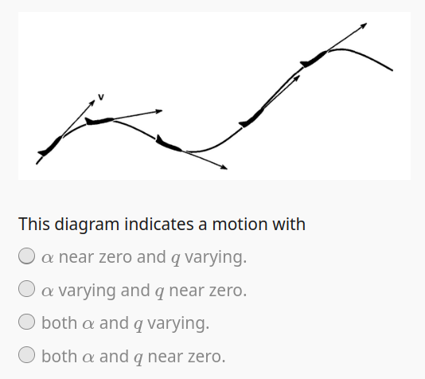
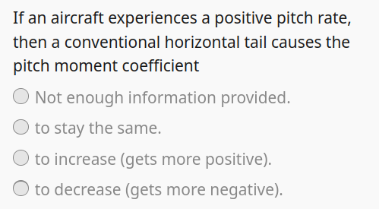
MC 5 + 6
Correct Answer: D
Correct Answer: A

Slide 12
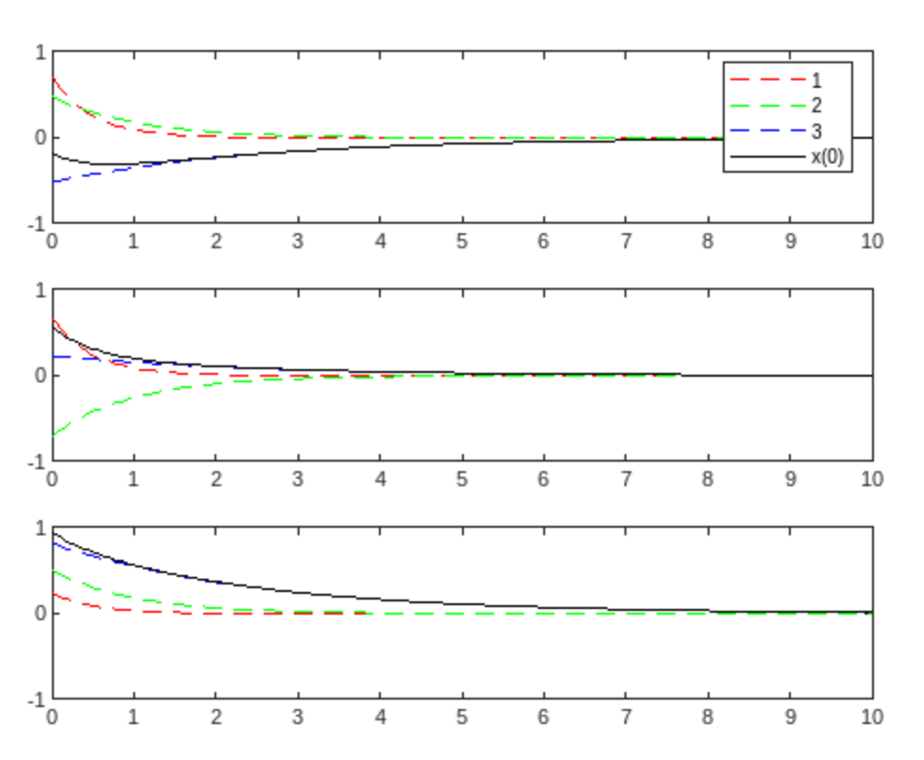
MC7
What q does this response correspond to?
A) [ 1, 0, 0]
B) [ 0, 1, 0.5]
C) [0.5, 0, 1]
D) [ 0, -1, 0.5]
E) [0.5, 0, -1]

Slide 13
MC8
If a conventional aircraft flies into a thermal updraft, which of the following best describes its response?
A) A phugoid oscillation only
B) A short period oscillation only
C) A phugoid oscillation that quickly decays, followed by a short period oscillation that decays more slowly
D) A short-period oscillation that decays quickly, followed by a phugoid oscillation that decays more slowly

Slide 14
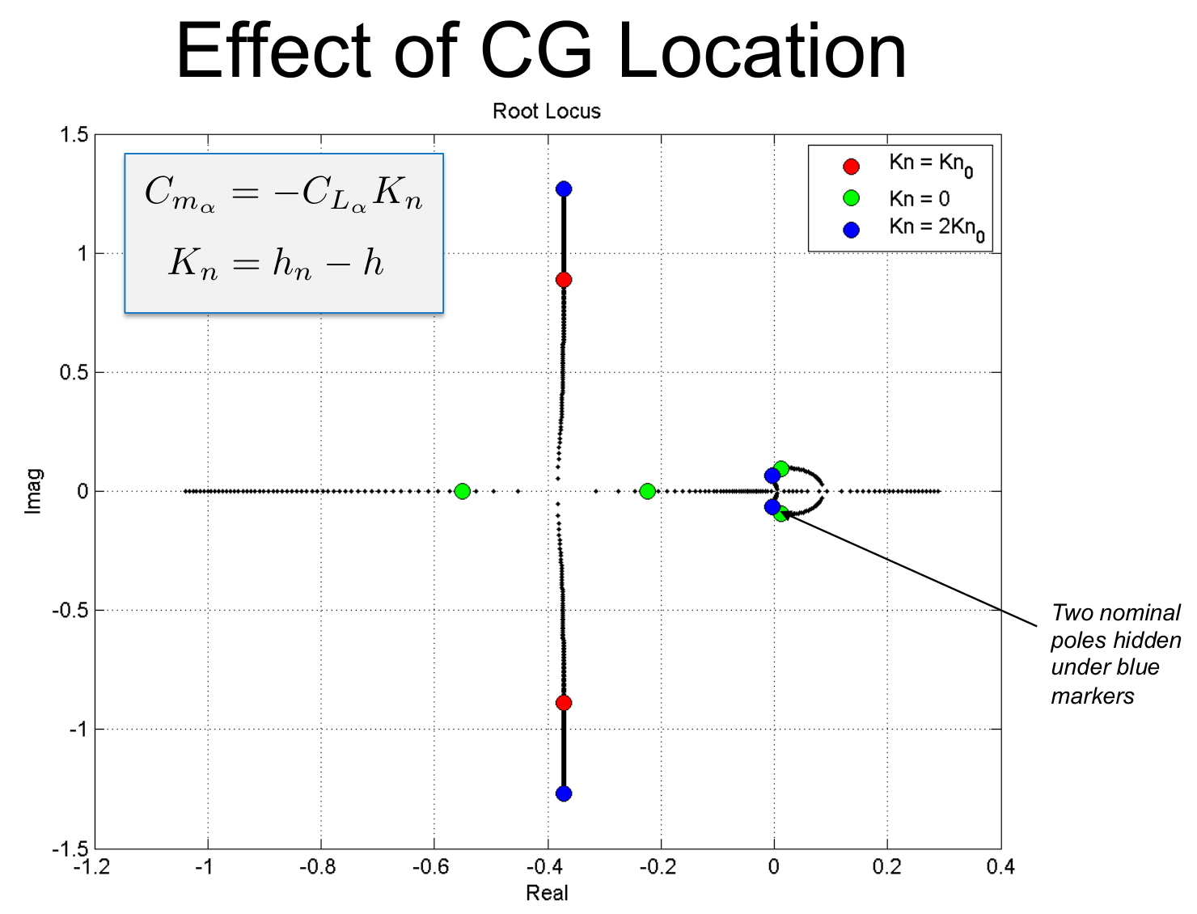
TF 3
True or False: Based on the root locus to the left, moving the CG backwards increases the natural frequency of the short period mode.
A) True: CG back → increase
B) False: CG back → decrease
CG back → h increasing → Kn is decreasing → decrease in natural frequency

Slide 15
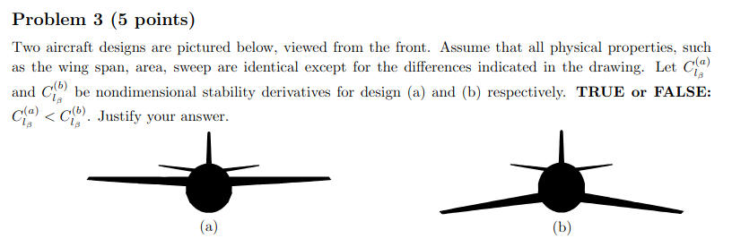
TF 4
A: TRUE: dihedral effect for (a) is less positive or more negative
B: FALSE: dihedral effect for (b) is less positive or more negative

Slide 16
TF-5
TRUE or FALSE. If all of the eigenvalues of the longitudinal dynamics matrix, A_lon, of a conventional aircraft have real components less than 0 (i.e. they are in the left half-plane) then we can conclude with certainty
that the aircraft is stable.
A. True
B. False

Slide 17
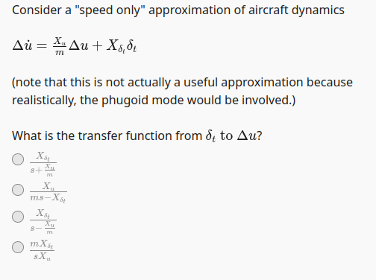
MC 9
A
B
C
D

Slide 18
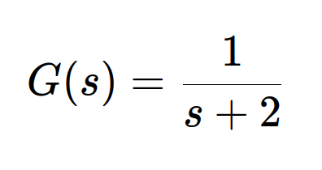
MC 10
Consider the system
What best describes the step response of the system?
A) Exponentially converging towards 1/2 with time constant 2
B) Decaying oscillations with damping ratio of 1/sqrt(2)
C) Exponentially converging towards 0 with time constant 2
D) Exponentially diverging
E) Exponentially converging towards 1/2 with time constant ½

Slide 19
MC 11
(Participation only) How long was the longest manned flight (in the atmosphere)?
Select highest without going over.
A) 48 Hours
B) 1 Week
C) 1 Month
D) 1 Year
E) One Decade

